Slide 1

AI-Driven Career Guidance: Your Future, Personalized
Unlock your potential and discover your ideal career path with personalized insights and actionable steps.

Slide 2
The Problem: Career Confusion in the Modern World
Rapid technological advancements and evolving job markets create uncertainty.
Individuals struggle to identify their strengths, interests, and career paths.

Slide 3

Our Solution: An AI-Powered Career Compass
1
Our AI analyzes your skills, interests, and personality.
2
It generates personalized career path suggestions and development plans.
3
It provides guidance and support every step of the way.

Slide 4
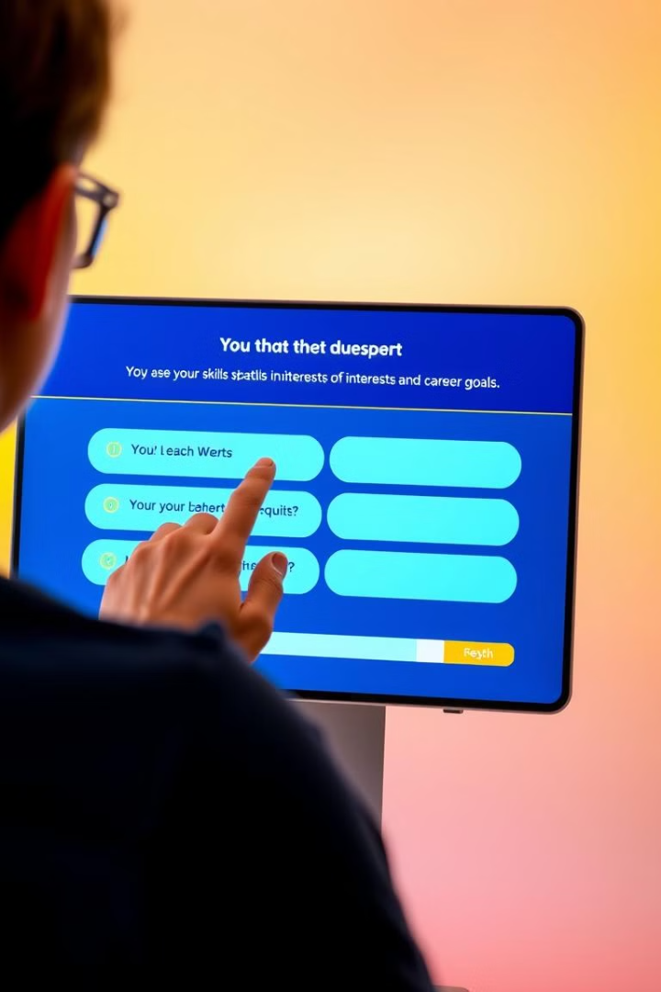
Skill & Interest Assessment: Unlocking Your Potential
Our platform conducts a comprehensive skill and interest assessment.
It identifies your existing skills and areas for growth.
It helps you understand your passions and career aspirations.

Slide 5




Personalized Career Path Suggestions: Examples
Software Engineer: Leverage your coding skills and passion for technology.
Physician: Combine your analytical skills with your desire to help others.
Musician: Pursue your creativity and artistic talent.

Slide 6
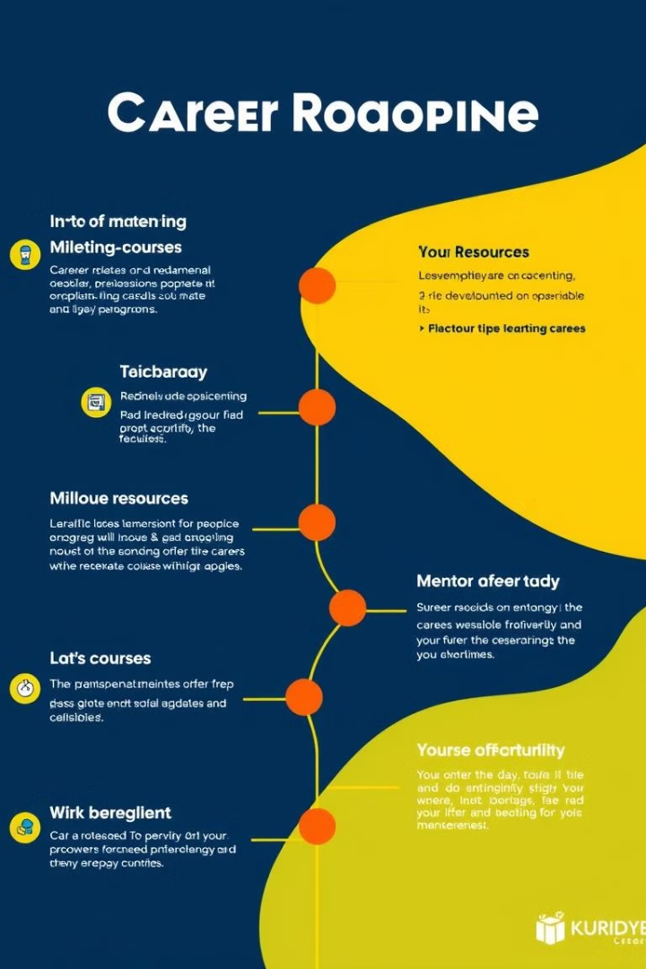
Development Plans: A Step-by-Step Guide
1
Tailored development plans outline the steps to achieve your goals.
2
It suggests relevant courses, certifications, and networking opportunities.
3
It provides a clear roadmap for career advancement and success.

Slide 7


Case Studies: Real Success Stories
Scientist
Business Executive
Our platform helped her identify her passion for research.
It guided him towards his ideal leadership role.

Slide 8
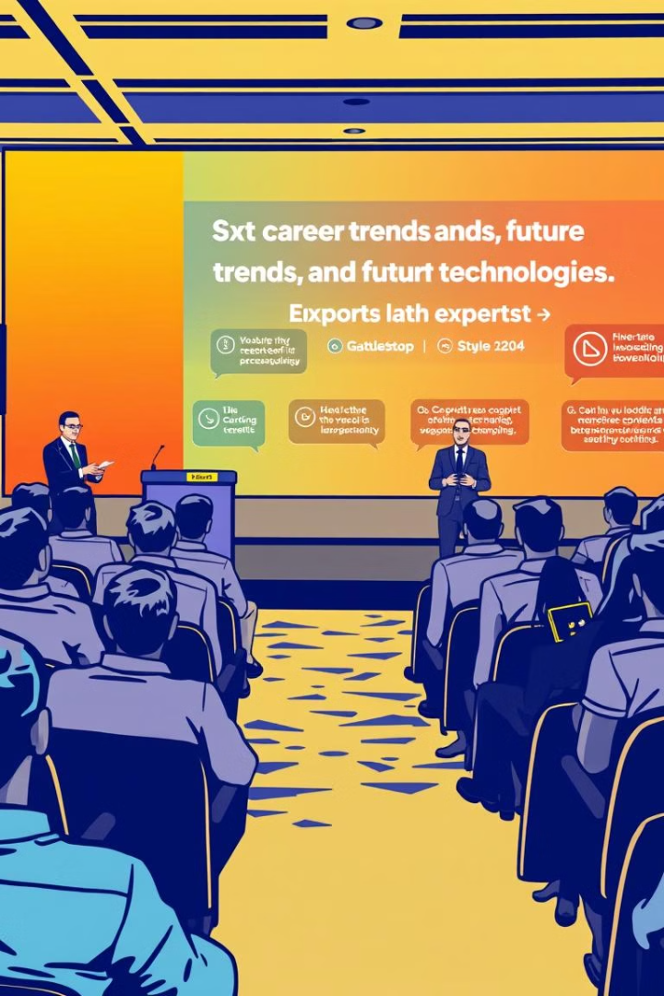
The Future of Career Guidance: Q&A
Join us for a Q&A session to learn about the evolving landscape of career guidance and the impact of AI on the future of work.

